Slide 1
Artificial Neural Networks -ANN
Synonymous to synapses and neurons in the brain
Can detect non-linear relationships
Inputs need to be numerically encoded

Slide 2
ANN Applications
Self-driving cars
Natural Language Processing
News Aggregation and Fraud detection (DeepFake)
Entertainment – Netflix, ESPN
Communication
Healthcare

Slide 3
Architecture of multilayer ANN

Slide 4
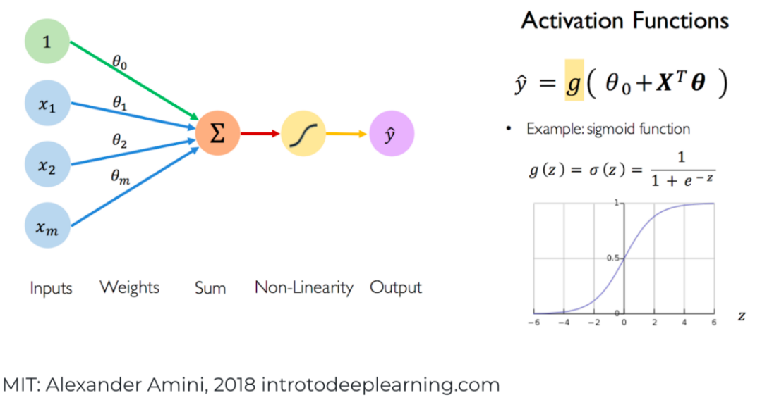
Neural Networks

Slide 5
Activation Functions
Linear Activation functions (y=bx)?
Not possible to do backpropagation - the derivative of the function is a constant, and has no relation to the input
Only linear relationships - the last layer will be a linear function of the first layer
Non-Linear Activation Functions
Sigmoid / Logistic
TanH / Hyperbolic Tangent
ReLU (Rectified Linear Unit)
Leaky ReLU
Softmax

Slide 6
Sigmoid / Logistic
Advantages
Smooth gradient, preventing “jumps” in output values.
Output values bound between 0 and 1, normalizing the output of each neuron.
Clear predictions—For X above 2 or below -2, tends to bring the Y value (the prediction) to the edge of the curve, very close to 1 or 0. This enables clear predictions.
Disadvantages
Vanishing gradient—for very high or very low values of X, there is almost no change to the prediction, causing a vanishing gradient problem. This can result in the network refusing to learn further, or being too slow to reach an accurate prediction.
Outputs not zero centered - output is always between 0 and 1; output after applying sigmoid is always positive hence, during gradient-descent, the gradient on the weights during backpropagation will always be either positive or negative depending on the output of the neuron. As a result, the gradient updates go too far in different directions which makes optimization harder.
Computationally expensive

Slide 7
TanH / Hyperbolic Tangent
Advantages
Zero centered—making it easier to model inputs that have strongly negative, neutral, and strongly positive values
Similar to Sigmoid
Disadvantages
Similar to Sigmoid

Slide 8
ReLU (Rectified Linear Unit)
Advantages
Computationally efficient—allows the network to converge very quickly
Non-linear—although it looks like a linear function, ReLU has a derivative function and allows for backpropagation
Disadvantages
The Dying ReLU problem—when inputs approach zero, or are negative, the gradient of the function becomes zero, the network cannot perform backpropagation and cannot learn – under fitting
Outputs not zero centered

Slide 9
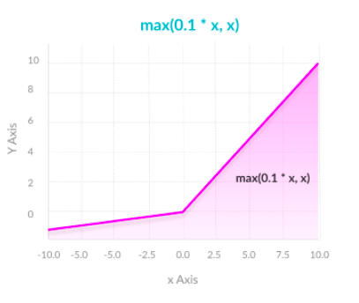
Leaky ReLU
Advantages
Prevents dying ReLU problem—this variation of ReLU has a small positive slope in the negative area, so it does enable backpropagation, even for negative input values
Similar to ReLU
Disadvantages
Results not consistent—leaky ReLU does not provide consistent predictions for negative input values.
Note: Use Parametric ReLU instead

Slide 10
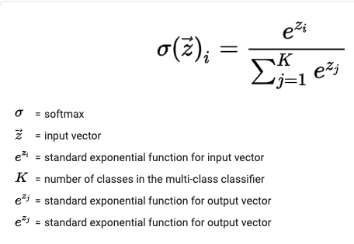
Softmax
Advantages
Able to handle multiple classes (only one class in other activation functions)—normalizes the outputs for each class between 0 and 1, and divides by their sum, giving the probability of the input value being in a specific class.
Useful for output neurons—typically Softmax is used only for the output layer, for neural networks that need to classify inputs into multiple categories.

Slide 11
Optimization Methods
Gradient Descent –
larger jumps over the cost function
miss the optimal value
may not converge for non-convex
Stochastic Gradient Descent
weight update at every sample, small steps
noisy and takes a lot of time
Min-Batch Gradient Descent
weight update after a few samples
less noisy
Adam
adds momentum, adaptive loss and acceleration

Slide 12
Loss functions
Regression
MSE
MAE
Psuedo-Huber Loss
Classification
Cross Entropy - Logloss
KL Divergence

